Slide 1

Atonement by Minute to Midnight
Notes:
1

Slide 2
Team project
Atonement, a singleplayer 2d platformer
If you liked hollow knight’s aesthetic, then you’d like Atonement’s
Can be found here
Notes:
You should have a working knowledge
of basic object-oriented programming concepts and at least some experience
programming in C++.
2

Slide 3
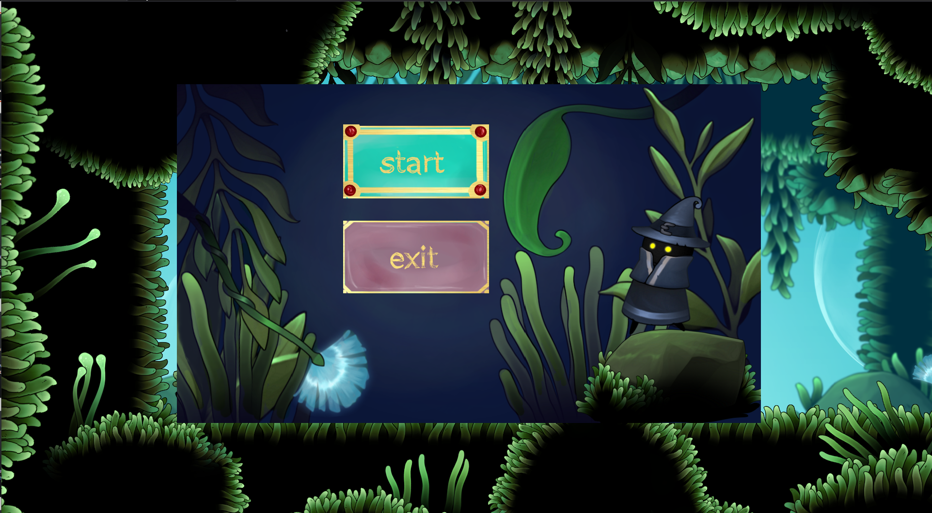
screenshots
Imagine a cool caption here
Notes:
The two players are getting ready for the race.
3

Slide 4
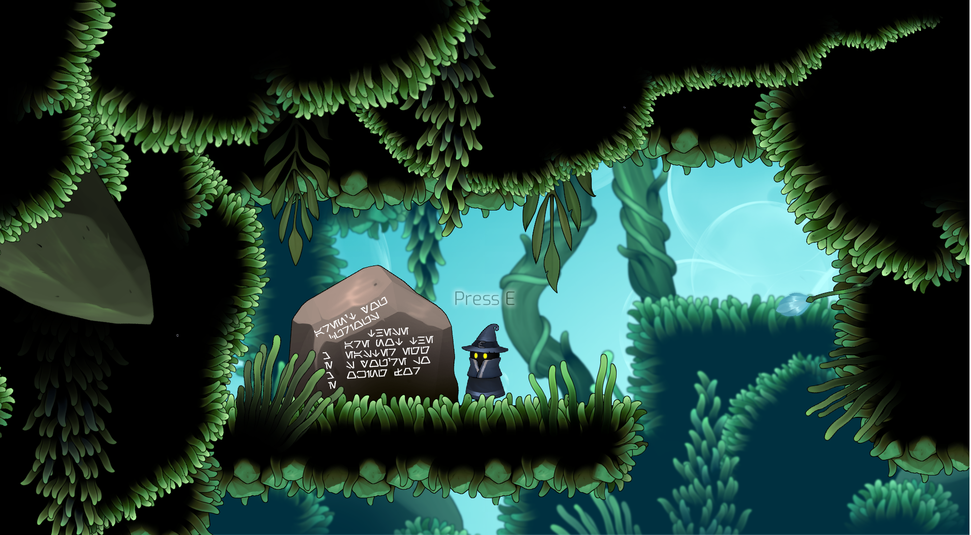
screenshots
Imagine a cool caption here
Notes:
The two players are getting ready for the race.
4

Slide 5
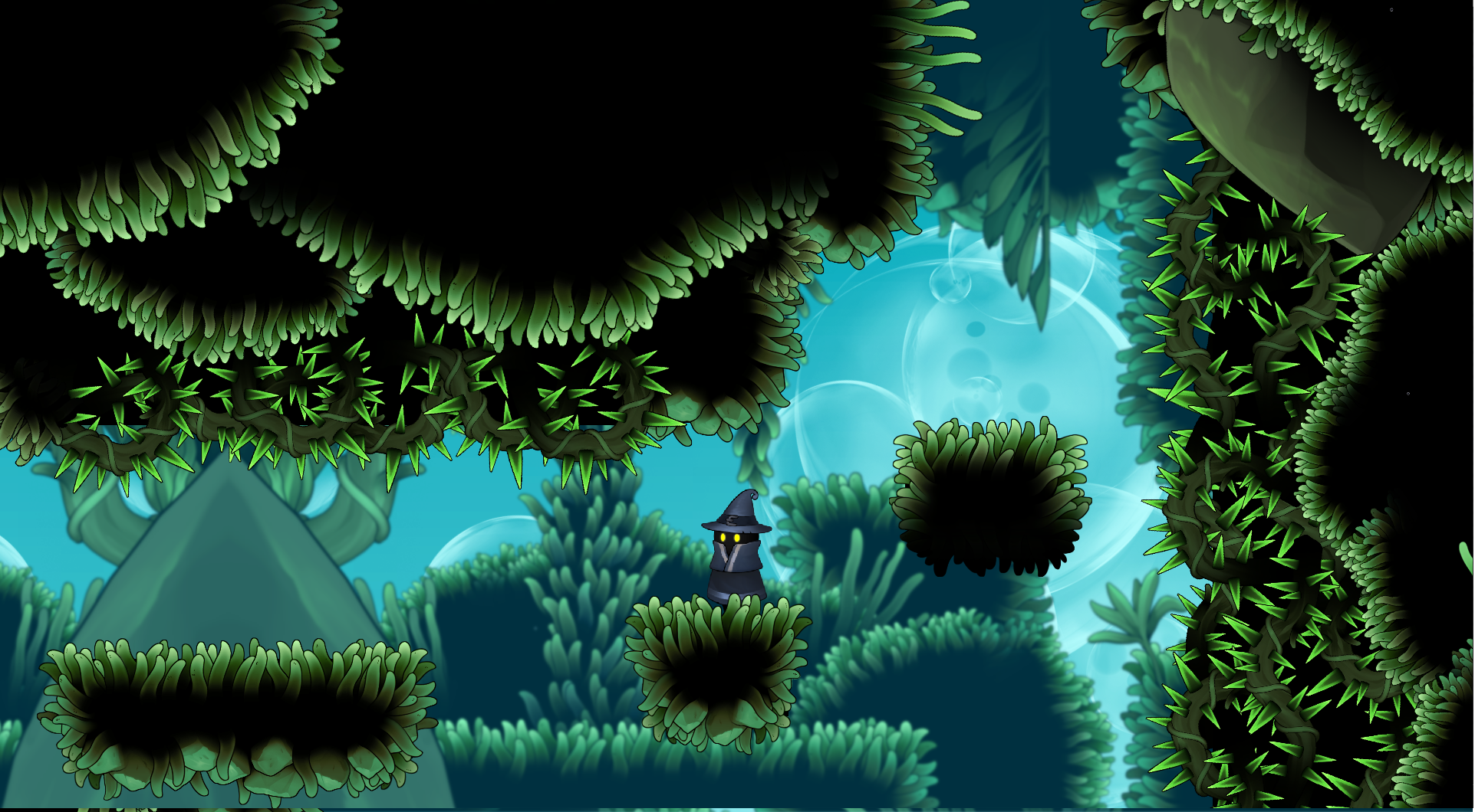
screenshots
Imagine a cool caption here
Notes:
The two players are getting ready for the race.
5

Slide 6
Team members
Jovan Đorđević, likes beans
Dunja Spasić, zen monk
Daringa Zobenica, Telekinetics engineer
Notes:
You should have a working knowledge
of basic object-oriented programming concepts and at least some experience
programming in C++.
6

Slide 7
Game description
You find yourself in a magical mossy cave
The player can run, jump, and unlock new abilities by interacting with runestones
Unlockable abilities are dash and wall jump
The goal is to reach the last runestone
Notes:
You should have a working knowledge
of basic object-oriented programming concepts and at least some experience
programming in C++.
7

Slide 8
Game description
Platforming has been designed to force the player to learn to use all of their abilities and time their jumps well
Also, the game is gorgeous (and the music is beautiful)
Notes:
You should have a working knowledge
of basic object-oriented programming concepts and at least some experience
programming in C++.
8

Slide 9
Game features: Movement
Controls: Player can move by using the keyboard
AWD – left, jump, right
Shift – dash
Space – triggers wall jump if you’re sliding down a wall when you press it
E – interacting with runestones
Notes:
You should have a working knowledge
of basic object-oriented programming concepts and at least some experience
programming in C++.
9

Slide 10
Game features: Movement
Movement is controlled through a state machine and includes a system for detecting whether the player is grounded and triggering them to fall if not, as well as a cooldown manager
Implemented by Darinka Zobenica
Notes:
You should have a working knowledge
of basic object-oriented programming concepts and at least some experience
programming in C++.
10

Slide 11
Game features: Parallax
Parallax background moving in the opposite direction from the player
New background images are being spawned when the player approaches the edge of the previous background image, mirrored so they’d loop nicely
Implemented by Darinka Zobenica
Notes:
You should have a working knowledge
of basic object-oriented programming concepts and at least some experience
programming in C++.
11

Slide 12
Game features: Custom Collision System
Detect player collisions from 4 sides
Place rectangular colliders on objects
React to various types of colliding objects (Solid, Deadly, Runestone)
Implemented by Jovan Đorđević & Darinka Zobenica
Notes:
You should have a working knowledge
of basic object-oriented programming concepts and at least some experience
programming in C++.
12

Slide 13
Game features: Checkpoints
When player death is detected, moves the player to the last checkpoint he passed by
Implemented by Jovan Đorđević
Notes:
You should have a working knowledge
of basic object-oriented programming concepts and at least some experience
programming in C++.
13

Slide 14
Game features: interaction with objects
The player can interact with runestones and acquire new abilities
Abilities are explained via tutorial messages
Implemented by Jovan Đorđević
Notes:
You should have a working knowledge
of basic object-oriented programming concepts and at least some experience
programming in C++.
14

Slide 15
Game features: GUI
Start menu: pressing the start button restarts the game, and exit button exits it. Start menu pauses the game and ability to unpause.
Implemented by Dunja spasić
Notes:
You should have a working knowledge
of basic object-oriented programming concepts and at least some experience
programming in C++.
15

Slide 16
Game features: GUI
pause menu: continue button unpauses the game. start menu button takes the player to start menu where they can restart the game.
Implemented by Dunja spasić
Notes:
You should have a working knowledge
of basic object-oriented programming concepts and at least some experience
programming in C++.
16

Slide 17
Game features: END SCREEn
End mechanics: Reaching the last runestone and interacting with it triggers and end screen, which takes the player back to main menu
Implemented by Dunja spasić
Notes:
You should have a working knowledge
of basic object-oriented programming concepts and at least some experience
programming in C++.
17

Slide 18
Implemented features
(not actual week-by-week timeline)
Jovan
Dagger practice
Editor Practice
Test level creation
And loading
Camera movement
and functional transforms & collisions in editor
Character collision and camera movement
Level design,
Movement variable adjusting
Level design,
checkpoints
Level design,
Interaction system
Level design,
Music
Dunja
Dagger practice
Testing game editing on ping pong
Pausing on ESC feature
Start menu buttons implement-ation
Start menu buttons, selection and background design
Pause menu design, pause menu connection to start menu, pausing ESC menu
Pause menu and start menu follow the camera
End screen design and implement-ation
End of game bug fixes
Darinka
Dagger practice
Ping pong feature
Movement FSM,
Input
Groundedness
Collisions
Cooldown Manager
Wall Jumping
Parallax
PR reviews, bug fixes
Photoshop background, prompts, instructions, stone colors
Notes:
You should have a working knowledge
of basic object-oriented programming concepts and at least some experience
programming in C++.
18

Slide 19
Postmortem
What went well?
We found great art and put a lot of effort into making it work with the engine so the game would have the mood we were aiming for
Everybody at least tested each other’s Features if they didn’t have the time to read all the code, so we’d make sure everything on main was (mostly) stable
Our work built off of each other’s work constantly
Notes:
You should have a working knowledge
of basic object-oriented programming concepts and at least some experience
programming in C++.
19

Slide 20
Postmortem
Features not implemented:
Using a combo for each movement ability
Intertia, better flow of movement
Runestones unlocking story elements
Bounce-jump
Polish like not falling off when standing on the edge of a collider, jump working even when you’ve slightly started to fall, not falling through colliders on really low fps, etc.
More than one level (at least one per asset pack was planned)
Story segments unlocked by runestones
Notes:
You should have a working knowledge
of basic object-oriented programming concepts and at least some experience
programming in C++.
20

Slide 21
Postmortem
What went wrong?
Initial plan with combos and multiple levels was slightly ambitious given our college obligations and free time
Movement was programmed on the go with a “I’ll refactor later” mindset, but by “later” many design decisions have been made based on it working exactly like it did
We didn’t factor in enough time for testing, PR approval, and bug fixes, so we ended up not studying for our exams quite as much as we’d planned (tragedy, I know)
Notes:
You should have a working knowledge
of basic object-oriented programming concepts and at least some experience
programming in C++.
21

Slide 22
Postmortem
If we could start over, we would:
Probably design around the tools we have, instead of the art we have
Make movement more inertia-based by adding vectors in certain directions and having gravity and friction counterbalance them
Notes:
You should have a working knowledge
of basic object-oriented programming concepts and at least some experience
programming in C++.
22

Slide 23
Postmortem
Some of the great additions to dagger would be:
A bit of polish of the level editor feature
Performance improvements (it can handle nowhere near 30 000 sprites per Second as was promised)
Visible (toggled) and rotatable colliders
Notes:
You should have a working knowledge
of basic object-oriented programming concepts and at least some experience
programming in C++.
23

Slide 24
Postmortem
What have we learned?
Entity-Component-system
A lot about ENTT
About git workflows
Things about designing and implementing platformers, we didn’t get to implement a lot of them, but we took notes!
Notes:
You should have a working knowledge
of basic object-oriented programming concepts and at least some experience
programming in C++.
24

Slide 25
We want to share...
Our thanks:
Thank you to harry for the CI pipeline (as well as all of the other help with linux) – saved lives on our mixed-os team
Big thank You To Miroslav for all his help on discord
Thanks to Filip for all the classes, feedback, and shared experiences
Thank you to Aleksandar Dimitrijević for detailed feedback on the Cooldown manager and useful lecture and discussion links
Thanks to other teams’ members, especially Vladimir Vuksanović, for being helpful on Discord and during class
Notes:
You should have a working knowledge
of basic object-oriented programming concepts and at least some experience
programming in C++.
25

Slide 26
We want to share...
Fail faster! :)
Notes:
You should have a working knowledge
of basic object-oriented programming concepts and at least some experience
programming in C++.
26

Slide 27
Thank you!
Notes:
You should have a working knowledge
of basic object-oriented programming concepts and at least some experience
programming in C++.
27

Slide 28
Questions
Notes:
You should have a working knowledge
of basic object-oriented programming concepts and at least some experience
programming in C++.
28

